Slide 1
Thousand words

Slide 2
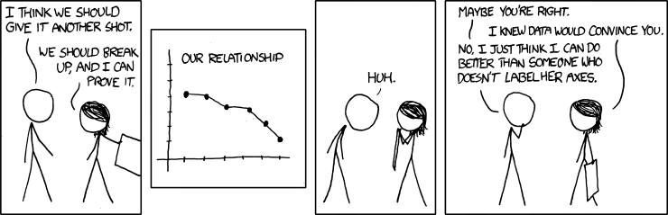
©xkcd

Slide 3
Why does it matter?
You can better understand your data.
The point of your work can reach more people.
Your work looks more professional.

Slide 4
A few rules...

Slide 5
Rule I
Whenever you are saving any figures do it in vector format.

Slide 6
Vector?
A = (1,4,2) ?

Slide 7
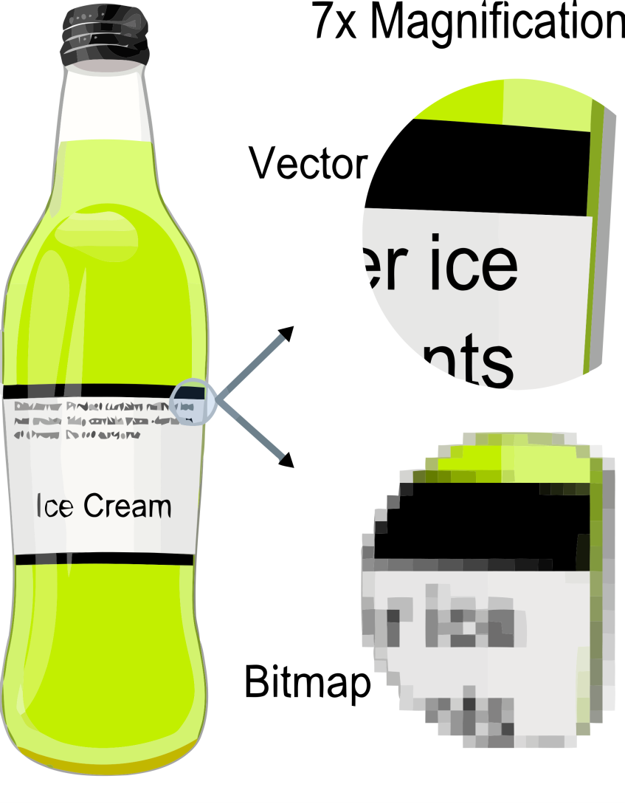

Vector vs. Bitmap

Slide 8
Vector graphic formats
PS
EPS
PDF
SVG
Both MATLAB and Matplotlib can save figures in eps and pdf. Take advantage of this.

Slide 9
Rule II
Automatically generate your figures.

Slide 10
Code separation
Simulations and/or data processing
Saving results
Figures and reports generation

Slide 11
Back up your code and figures often
The most important part of your process is your code. It will allow you to recreate the results and figures.
Think of figures as of results in a concise form. Facing disaster and limited time they will allow you to make this crucial poster on time.

Slide 12
Back up your code and figures often
Figures can be put into a version control system together with your code. This way you would be able to get a snapshot of the code and the results from the past.

Slide 13
Rule III
When you are generating figures just for yourself try to make them as close to publishing quality as possible.*
* within a reason

Slide 14
Publishing quality?
Label axes and units.
Add a legend.
Use sensible colours.
Less is more (don't make the figures too crowded).
...but don't spend ages trying to do this.

Slide 15
Why?
Right now you totally know what is on the figure but in two years* you will probably forget.
* or whenever your funding will run out and you'll decide to start writing up

Slide 16
Tools of the trade

Slide 17
Matplotlib
Python based.
With built-in layout manager.
On top of eps, ps can also create svg.
Simple 3D support.
You can embed it into your application.

Slide 18
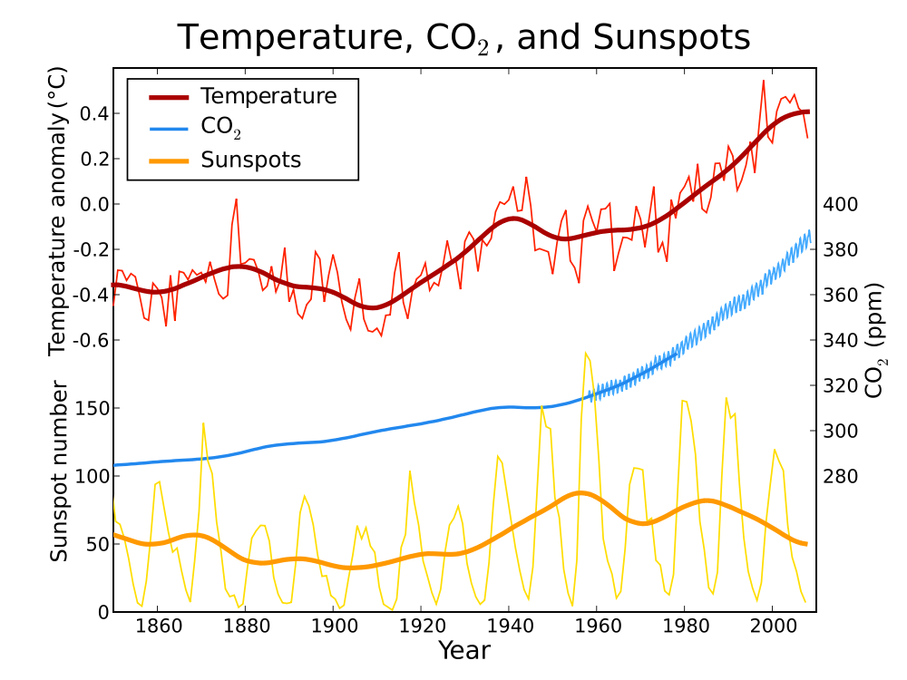

Slide 19
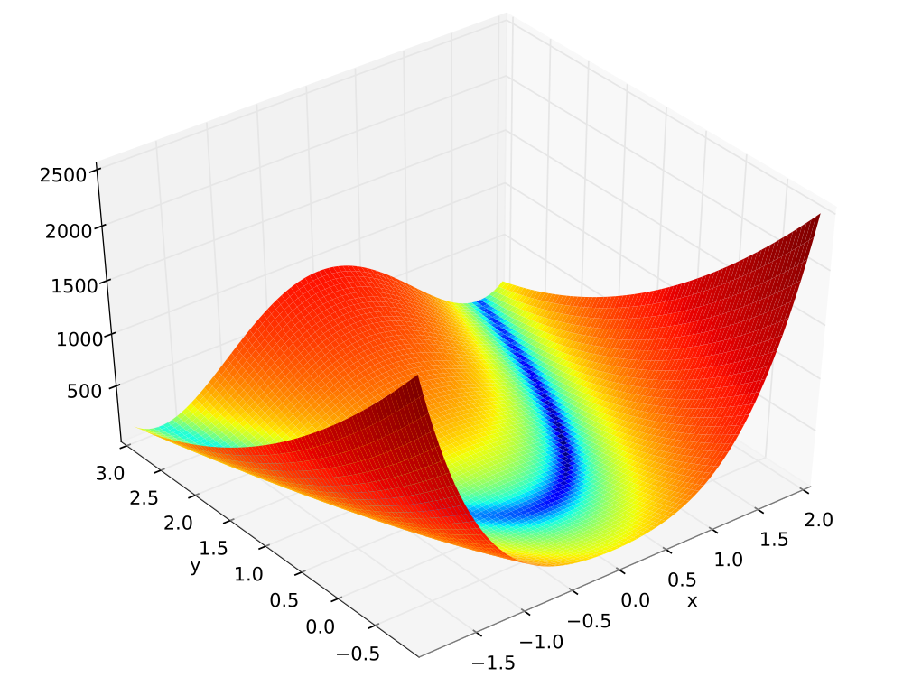

Slide 20
Mayavi2
Powerful framework for generating and interacting with 3D visualisations.
Compatible with Python.
Has a good interactive editor.
Can create videos.

Slide 21
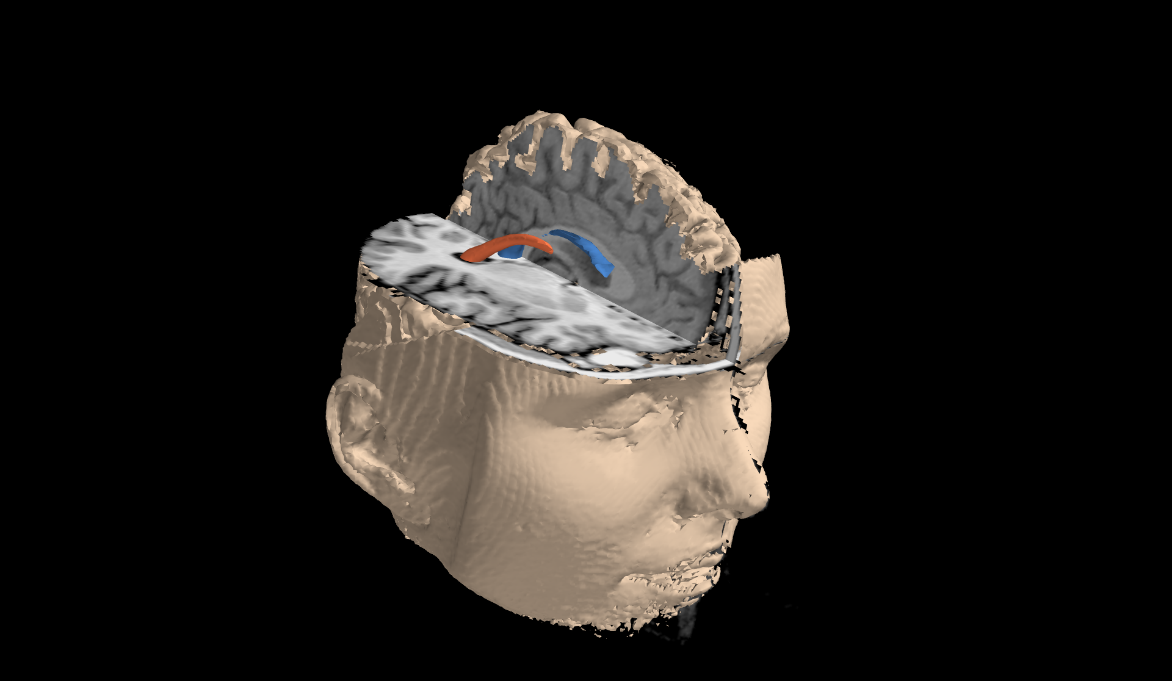

Slide 22
Inkscape
Is a vector graphic editor.
Good for creating diagrams and correcting your graphs.
Demonstration

Slide 23
Conversion
Bitmap
convert (part of ImageMagick)
Vector
ps2pdf, pdf2ps
inkscape

Slide 24
Bitmaps are evil but...
Sometimes you just have to use them.
What then? How should you generate or convert your figures?

Slide 25
Bitmaps
Step One:
Think how big your figure should be in
the real world.*
* The thing you can read about on bbc.co.uk

Slide 26
Bitmaps
Step Two:
Check what is the resolution your figure is going to be printed with. In doubt assume it is 300 Dots Per Inch (DPI).

Slide 27
Bitmaps
Step Three:
Calculate the size that you need to generate your figures:
<real size> × <DPI> = <pixel size>

Slide 28
Would you attend a matplotlib tutorial?
http://doodle.com/gb9cvuxvmztw9q5b

